Slide 1
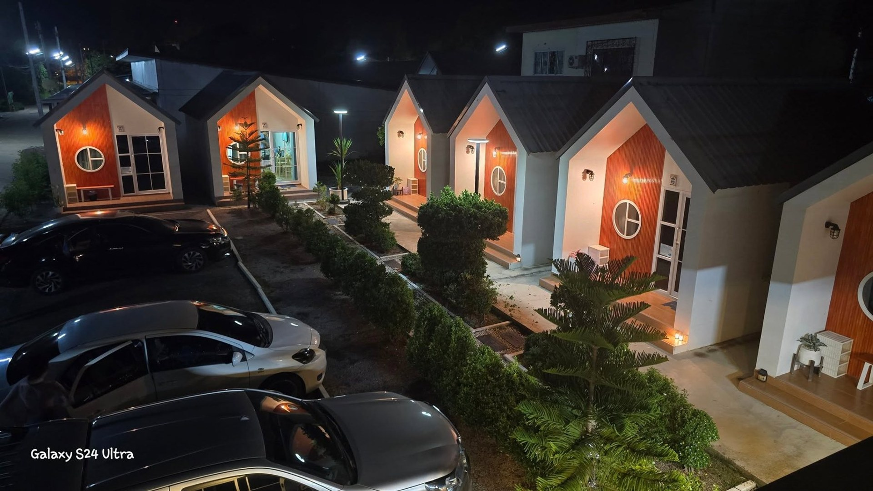


Poonsuk Resort
Resort Booking & Management App
Guests book a cottage in minutes. The resort runs every booking, payment and room from one app.
RBMA · Mobile app for Poonsuk Resort @Sadao, Songkhla
Notes:
Open with the picture: this is Poonsuk Resort in Sadao at night. Our pitch is simple: we put the whole resort in a phone. Guests can book on their own, any time, and the team can run bookings, payments and rooms from one app.

Slide 2
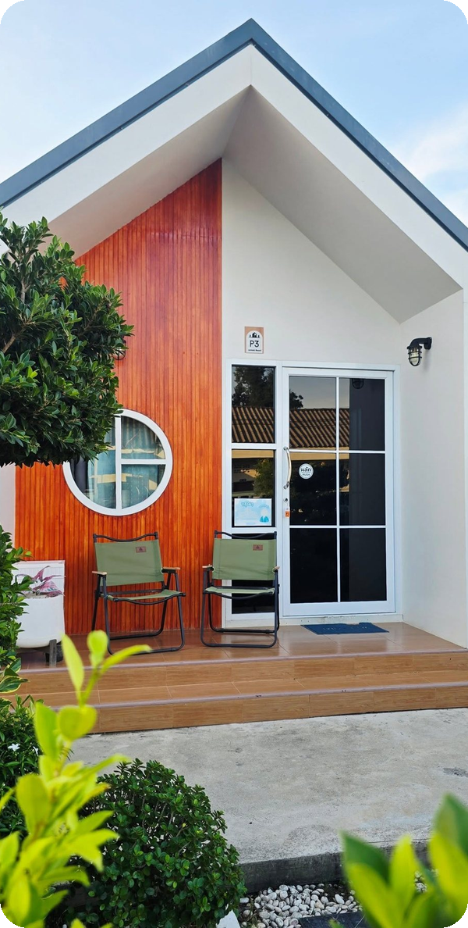
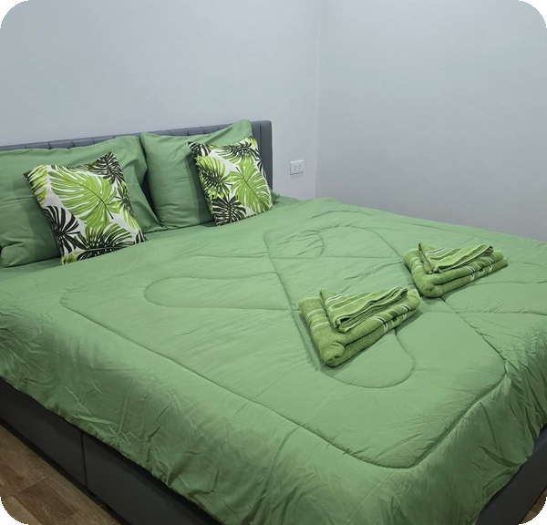
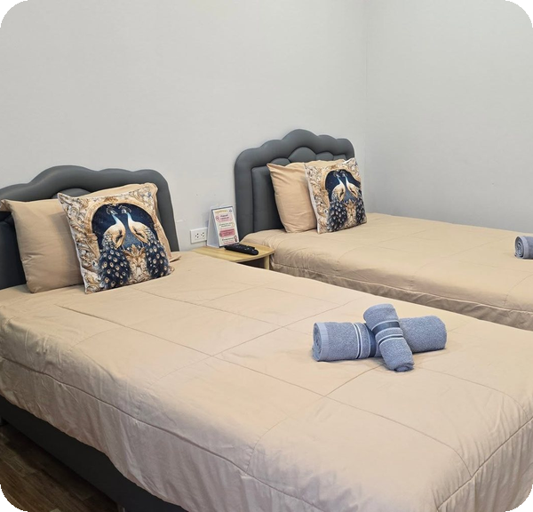



THE RESORT
Cosy cottages in Sadao, Songkhla
Poonsuk Resort @Sadao welcomes guests to bright A-frame cottages, each with its own porch, private bathroom and garden path.
Single · king-size bed, up to 2 guests
Twin · two beds, up to 2 guests
Check-in 14:00 · Check-out 12:00
Wi-Fi · Air conditioning · TV · Coffee in every room
Poonsuk Resort · RBMA
02
Notes:
This is the customer we built for. Poonsuk Resort in Sadao, Songkhla: A-frame cottages in two room types, Single with a king-size bed and Twin with two beds. Check-in is 14:00 and check-out is 12:00. Every room has Wi-Fi, air conditioning, TV and coffee.

Slide 3




THE PROBLEM
Booking by phone and paper loses guests and money
Slow and error-prone
Rooms sold twice
No shared tool
Bookings taken by phone and on paper take time and invite mistakes.
With no real-time availability check, the same room can be booked twice.
Staff have no single place to manage rooms and bookings together.
No live numbers
Guests left guessing
Costly commissions
The owner can't see bookings and revenue as they happen.
Customers can't check the status of their own booking.
Leaning on online travel agencies (OTAs) means paying high commission.
Poonsuk Resort · RBMA
03
Notes:
Today a stay starts with a phone call and the booking lives on paper. That creates six concrete gaps. Slow manual work, rooms at risk of being sold twice, no shared tool for staff, no live numbers for the owner, guests who can't see their booking status, and a dependence on travel sites that take a large commission.

Slide 4


OUR SOLUTION
One app, two sides, open 24/7
For guests
For the resort team
Search rooms that are free on your dates
Book and pay by PromptPay QR
Track every booking in one place
Get an automatic confirmation email
Find the resort and places to eat nearby
Approve bookings and verify payment slips
See every room on one calendar
Add rooms, change prices, flag maintenance
Check guests in and out
Live dashboard, reports and staff accounts
Poonsuk Resort · RBMA
04
Notes:
Our answer is one mobile app with two sides. Guests get self-service booking around the clock. The resort team, staff and admins, sign in to the same app and get a full back office. Both sides share the same live data, so what a guest books is what staff see.

Slide 5
HOW BOOKING WORKS
A stay booked in six simple steps
1
2
3
4
5
6
Choose dates
Pick a room
Book it
Scan & pay
Staff confirm
Email arrives
Booked rooms vanish; only free ones show.
Photos, amenities, capacity and price.
The room is held for you while you pay.
PromptPay QR for the exact total, then upload the slip.
The resort checks the slip right in the app.
Confirmation with dates, total and booking number.
No phone call needed — the whole booking happens in the app.
Poonsuk Resort · RBMA
05
Notes:
Walk the guest journey left to right. Choose dates and only free rooms appear. Pick a room and see photos and price. Booking holds the room for a short payment window. The guest scans a PromptPay QR that already has the exact total, pays with any banking app and uploads the slip. Staff confirm the slip in the app, and the confirmation email goes out automatically.

Slide 6
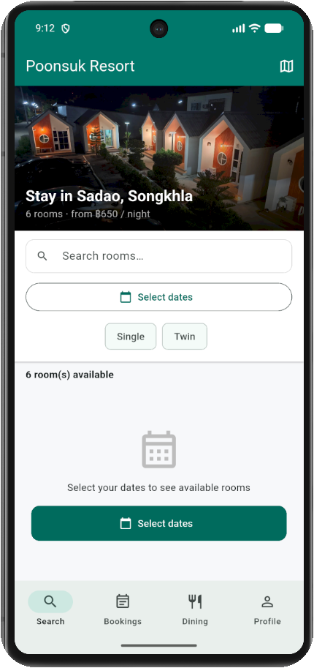




FEATURE · FIND A ROOM
See only rooms that are really free
Pick your dates
Rooms already booked for those nights disappear instantly.
Filter your way
Single or Twin, or type a room name.
Live for everyone
Availability reflects every guest's bookings, so what you see is bookable.
Know before you book
Photos, amenities, guest capacity and nightly price for every room.
Poonsuk Resort · RBMA
06
Notes:
This is the real home screen: the resort photo on top shows how many rooms there are and the starting price, live from the system. Search is built around dates. Once a guest picks check-in and check-out, any room already taken for those nights simply drops out of the list, and the check covers every customer's bookings, not just their own. Filter by Single or Twin, or search by name, then open a room for photos, amenities, capacity and price.

Slide 7
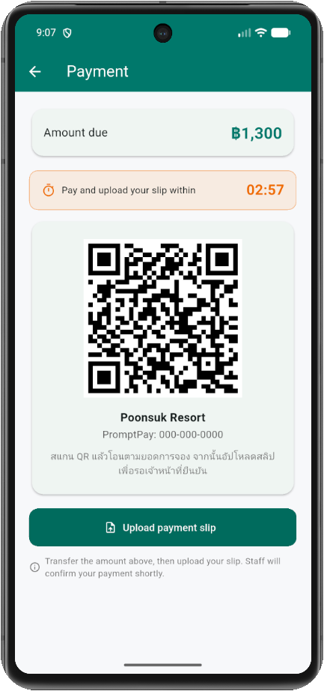



FEATURE · PAY
Pay the way Thailand already pays
PromptPay QR, exact amount
The app makes a QR for the booking total. Scan it with any Thai banking app.
Upload the slip, staff verify
A rejected slip comes back with the reason, and the guest can upload a new one.
Rooms never sit blocked
A countdown holds the room while the guest pays. Unpaid holds are released automatically.
No card data stored
The app never keeps card or bank account numbers.
Poonsuk Resort · RBMA
07
Notes:
Payment uses PromptPay, which every Thai guest already knows. The app generates a QR code with the exact booking total, the guest pays from their own banking app and uploads the transfer slip. Staff check the slip in the Payments tab; if something is wrong, they reject it with a reason and the guest can upload again. While the guest pays, a countdown holds the room, and if nobody pays, the hold is released automatically so the room goes back on sale. No card or bank account numbers are ever stored. The screen on the right is the real payment page: the exact amount due, the countdown, and the QR.

Slide 8




FEATURE · STAY INFORMED
Guests always know where they stand
My bookings
Every booking with its status: Pending, Approved, Checked in, Checked out or Cancelled.
Booking confirmation email
ยืนยันการจองห้อง … — Poonsuk Resort
Plans changed? Cancel in the app
Guests can cancel before check-in day, with a confirm step so nothing happens by accident.
Room name
Check-in date, from 14:00
Check-out date, by 12:00
Nights and number of guests
Total paid
Booking number
Forgot the password? No problem
A verification code is emailed so guests can set a new one themselves.
Sent in Thai the moment staff confirm the payment.
Poonsuk Resort · RBMA
08
Notes:
After booking, guests are never left guessing. My Bookings shows every booking and where it is, and pulling down refreshes it. They can cancel before the check-in day, with a confirmation step. When staff approve the payment, a confirmation email goes out automatically in Thai with the room, dates and check-in times, nights, guests, total paid and booking number. A forgotten password is reset with a code sent by email.

Slide 9
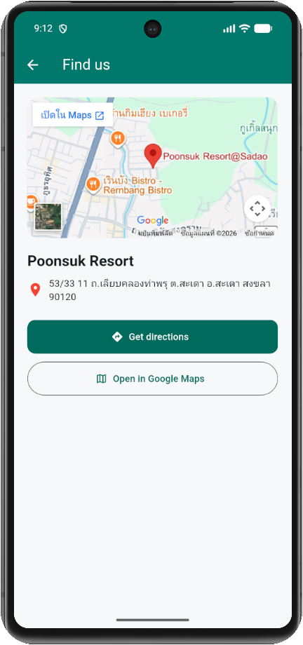

FEATURE · EXPLORE
Find the resort, and dinner nearby
Hotel location
A map of the resort with Get directions and Open in Google Maps, straight to the Poonsuk Resort@Sadao listing.
Nearby dining
Restaurants around the resort with cuisine, rating and distance, plus View on map and Directions.
FIND US
53/33 11 ถ.เลียบคลองท่าพรุ ต.สะเดา อ.สะเดา สงขลา 90120
Poonsuk Resort · RBMA
09
Notes:
The app also helps guests before and during the stay. The location page shows the resort on a map and opens Google Maps directions straight to the Poonsuk Resort@Sadao listing. The Dining tab lists restaurants around the resort by distance, with a map and directions for each.

Slide 10

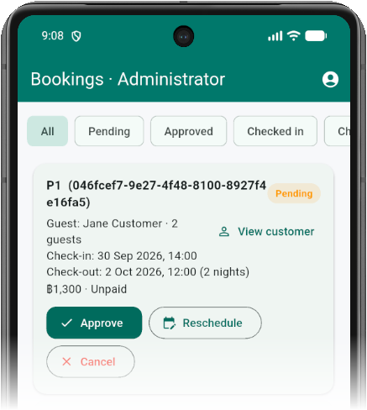
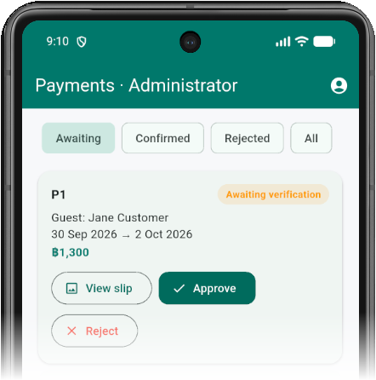
FOR THE RESORT TEAM · EVERY DAY
Run the front desk from one phone
Approve, reschedule or cancel
Each booking shows the guest, dates, nights and total. Filter by Pending, Approved or Checked in.
Verify payment slips
Open the guest's transfer slip, then approve it, or reject it with a reason.
Check guests in and out
Mark arrivals and departures in one tap once the booking is paid.
Payments tab
Bookings tab
Poonsuk Resort · RBMA
10
Notes:
Now the resort side. Staff and admins sign in to the same app and land in the back office. Everything the front desk does each day is here. In the Bookings tab they approve, reschedule or cancel, and filter by status. In the Payments tab they open the guest's transfer slip and approve it, or reject it with a reason. When guests arrive and leave, check-in and check-out are one tap, for paid bookings only.

Slide 11
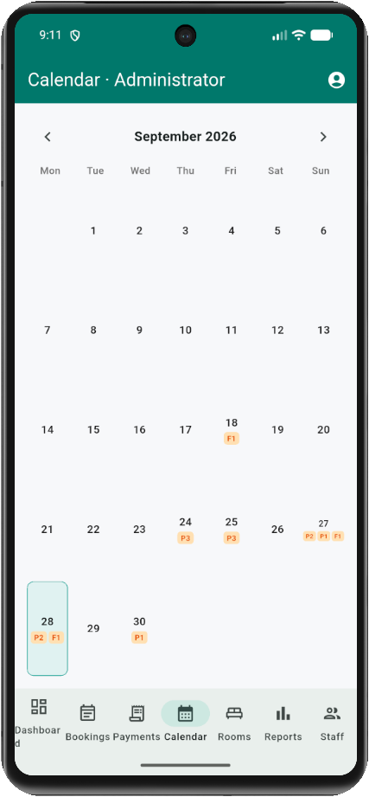
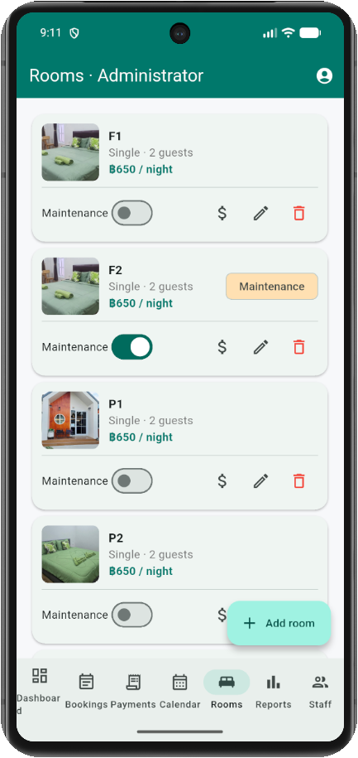
FOR THE RESORT TEAM · SETUP
Manage rooms, calendar and staff
Rooms in a few taps
Add or edit rooms, set the nightly price, and add photos from the camera or gallery.
Maintenance switch
Flip it and the room disappears from guest search until it is ready again.
Month calendar
See which rooms are booked each day; tap a day for the guest and room details.
Staff and access
Admins create or remove staff and admin accounts. Staff handle the daily work.
Poonsuk Resort · RBMA
11
Notes:
Setting up and running the property is just as simple. The Rooms tab adds or edits rooms, sets prices and takes photos straight from the phone. The maintenance switch hides a room from guest search until it is ready. The month calendar shows which rooms are booked each day, and tapping a day lists every room with its guest. Admins manage staff accounts; staff only do the daily work.

Slide 12
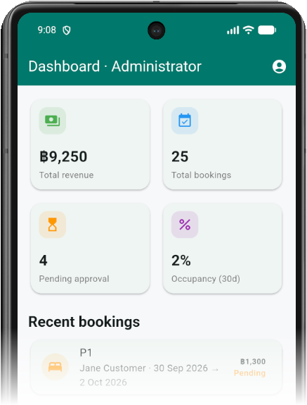




FOR THE OWNER
See how the resort is doing, live
Total revenue
Total bookings
Added up from every paid booking.
Every reservation, in one count.
Pending approval
Occupancy
What still needs the team's attention.
Share of room-nights booked over the next 30 days.
Reports add bookings by status and a room inventory: how many rooms are available and how many are under maintenance.
Poonsuk Resort · RBMA
12
Notes:
For the owner, the point is visibility. The dashboard on the left is the real admin screen: total revenue from paid bookings, total bookings, how many are still waiting for approval, and occupancy over the next 30 days, plus the most recent bookings. Reports add a bookings-by-status chart and a room inventory. No more waiting for the end of the month to know how the resort is doing.

Slide 13


BUILT TO BE TRUSTED
A room is never sold twice
No double bookings
Prices you can trust
The system refuses overlapping stays. Tested: two guests booking the same room at the same moment, and exactly one gets it.
The total is worked out by the resort's server from the room's nightly rate, never by the guest's phone.
Safe accounts
Problems caught early
Passwords are stored encrypted, repeated login attempts are limited, and each role sees only what it should.
Error monitoring on both the app and the server flags crashes so the team can fix them fast.
Poonsuk Resort · RBMA
13
Notes:
A booking system is only useful if the resort can rely on it. Overlapping stays for the same room are rejected by the database itself, and we test the worst case: two guests booking the same room at the same instant, where exactly one succeeds and the other is told the room was just taken. Prices are calculated on the server, not the phone. Passwords are stored as secure hashes, login attempts are rate-limited, and roles control who can do what. Sentry error monitoring watches both the app and the server.

Slide 14
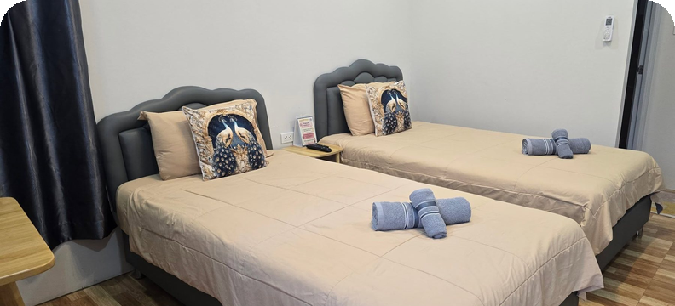
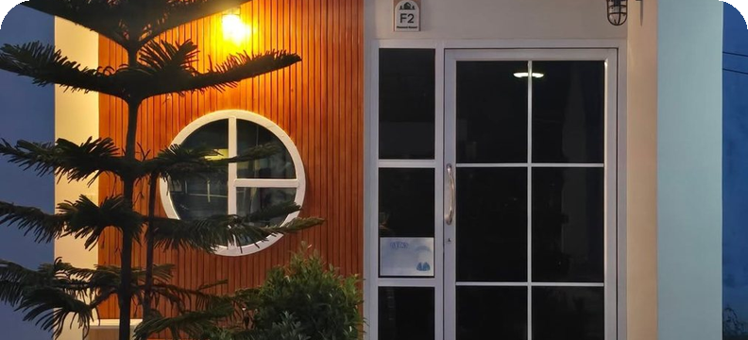
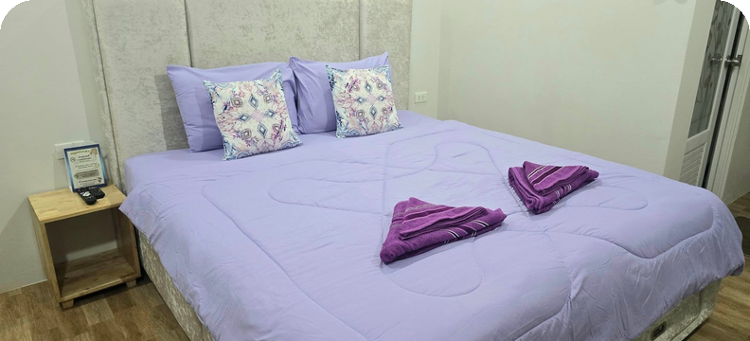
THE BENEFITS
Everyone at the resort wins
Guests
Owner
Staff
Book on their own, any time of day, in a few taps, and always know the status of their stay.
More direct bookings, less reliance on high-commission travel sites, and live revenue and occupancy.
Less paperwork, fewer data-entry mistakes, and one shared calendar instead of a notebook.
Poonsuk Resort · RBMA
14
Notes:
To close, the value for each group. Guests get convenience: self-service booking 24 hours a day on an easy app. The owner gets more chances to earn from direct bookings and relies less on travel agencies that charge high commission, with live numbers on top. Staff get less paperwork and fewer data-entry mistakes.

Slide 15
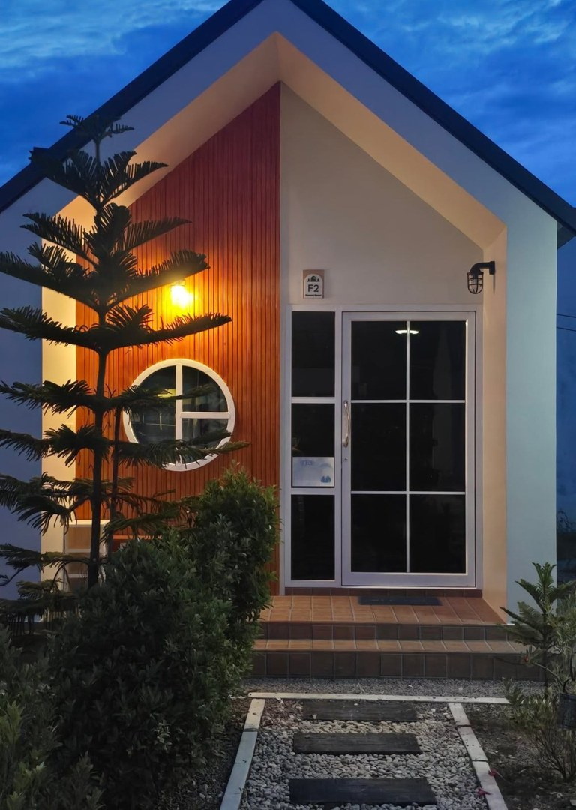
Thank you
ขอบคุณครับ · Questions and suggestions are welcome
Peeranat Pathomkul · 6610110214
Phonlawat Thaenthong · 6610110196
Pawaris Phansatithwong · 6610110173
Resort Booking and Management Application (RBMA)
Notes:
Thank the audience, introduce the team, and open the floor for questions and suggestions.

